Slide 1

Traffic Sign Recognition System Using CNN and Image processing
Under Guidence of:
Dr. P.V.Rama Raju
TEAM:
S.S.V.SURYA TEJA(17B91A04K2)
A.S.POOJA PRAVALLIKA(17B91A04J9)
N.NIKHIL(17B91A04G6)
S.T.S.BHAGAVAN(17B91A04L3)

Slide 2
Contents:
Abstract
Traffic Signs Recognition
Solution Description
Algorithm Description
Contrast image
Masking image
Canny edge detection
Contour Handling
Classification
Voting
Reconciliation
Convolutional Neural Network
Classification report of models
Output
Conclusion

Slide 3
Abstract–
In today’s world, almost everything we do has been simplified by automated tasks. In an attempt to focus on the road while driving, drivers often miss out on signs on the side of the road, which could be dangerous for them and for the people around them.
This problem can be avoided if there was an efficient way to notify the driver without having them to shift their focus. Traffic Sign Detection and Recognition (TSDR) plays an important role here by detecting and recognizing a sign, thus notifying the driver of any upcoming signs. This also ensures that the road we were travelling is safety.
You must have heard about the self-driving cars in which the passenger can fully depend on the car for traveling. But to achieve level 5 autonomous, it is necessary for vehicles to understand and follow all traffic rules.
In the world of Artificial Intelligence and advancement in technologies, many researchers and big companies like Tesla, Uber, Google, Mercedes-Benz, Toyota, Ford, Audi, etc are working on autonomous vehicles and self-driving cars. So, for achieving accuracy in this technology, the vehicles should be able to interpret traffic signs and make decisions accordingly.

Slide 4
Traffic Signs Recognition
Traffic-sign recognition (TSR) is a technology by which a vehicle is able to recognize the traffic signs put on the road e.g. "speed limit" or "children" or "turn ahead". This is part of the features collectively called ADAS. The technology is being developed by a variety of automotive suppliers.
It uses image processing techniques to detect the traffic signs. The detection methods can be generally divided into color based, shape based and learning based methods.
There are several different types of traffic signs like speed limits, no entry, traffic signals, turn left or right, children crossing, no passing of heavy vehicles, etc. Traffic signs classification is the process of identifying which class a traffic sign belongs to.
We will build a deep neural network model using Tensorflow in Colab that can classify traffic signs present in the image into different categories. With this model, we are able to read and understand traffic signs which are a very important task for all autonomous vehicles.

Slide 5
Softwares And Datasets:
Python
Tensorflow
Colab
OpenCV
German Traffic-Sign Dataset(GTSRB)

Slide 6
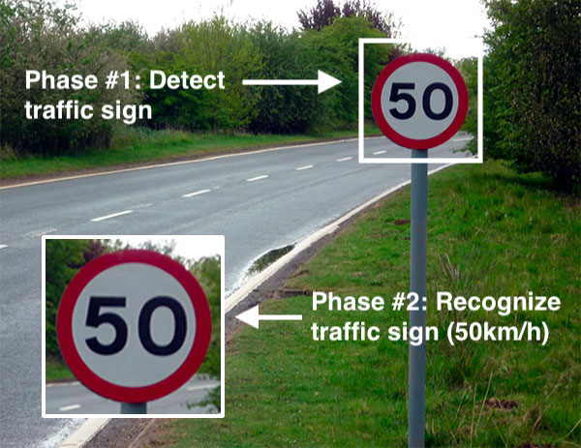

Slide 7
Solution Description--
Detection : The image is first preprocessed, so that the signs can be detected more easily, in a geometric manner.
Preprocessing consists of
a)enhancing the contrast, so that colors can be recognized more easily;
b) filtering the image in such a manner that only colors that may represent a traffic sign remain, the rest being faded to black;
c) applying the canny edge detection algorithm;
d) And finally binarizing the image.
After the image was preprocessed, the small components are removed, all the external contours are found and the sign having the greatest distance from its center to the contour is extracted from the image.
Finally, a square image is cropped, based on the sign’s contour.
Classification :
It is done using CNNs(Convolutional Neural Networks), which implement a voting method.
Each CNN has a different architecture, so that they behave differently, otherwise voting will have no importance.
For the models, training is done on the “The German Traffic Sign Recognition Benchmark” dataset .

Slide 8
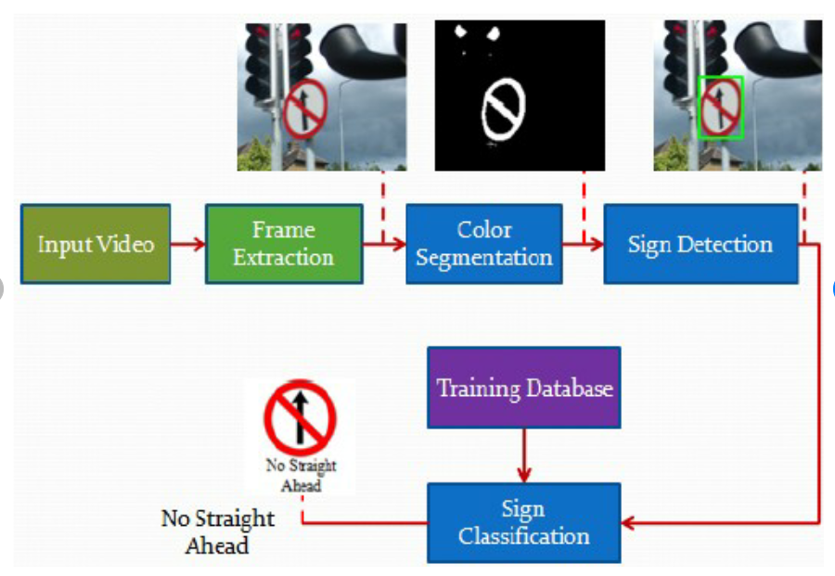
Reconciliation :
Reconciliation must finally be obtained between the two parts which were largely developed separately.
The output of the detection algorithm, which will be the input of the CNN, must resemble the images the CNN was trained on. That way, the accuracy should be as high as possible.
When classification works satisfyingly enough for each model separately, voting should be implemented.

Slide 9
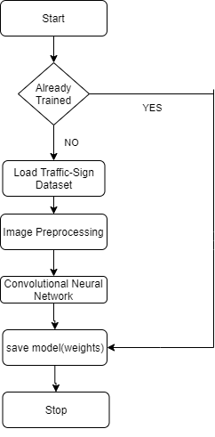
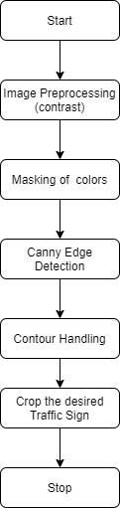
TRAINING AND DETECTION FLOWCHART

Slide 10
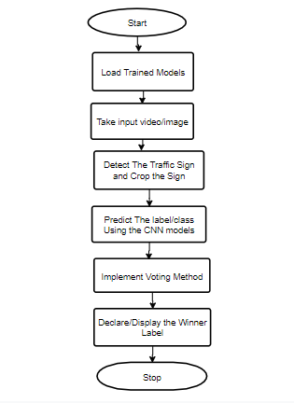
RECONCILIATION Flowchart:

Slide 11
Algorithm Description:
Traffic Sign Detection(TSD) includes different algorithm steps which include :
A)Contrast image
B)Masking
C)Canny edge detection
D)Contour handling
E)Classification
F)Voting
G)Reconciliation

Slide 12
Contrast image:
Contrast is the difference in luminance or color that makes an object (or its representation in an image or display) distinguishable. In visual perception of the real world, contrast is determined by the difference in the color and brightness of the object and other objects within the same field of view.
The human visual system is more sensitive to contrast than absolute luminance; we can perceive the world similarly regardless of the huge changes in illumination over the day or from place to place. The maximum contrast of an image is the contrast ratio or dynamic range.
The image is first converted to YCrCb colorspace, consisting of Y - luminance or Luma, Cr - how far Luma is from the red component and Cb - how far Luma is from the blue component.
Then the histogram of the Luma is equalized, spreading out the values from any cluster, and finally, the image is converted back to RGB.

Slide 13
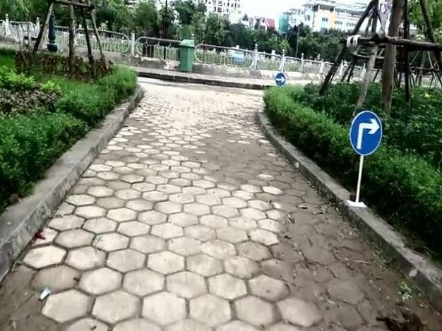
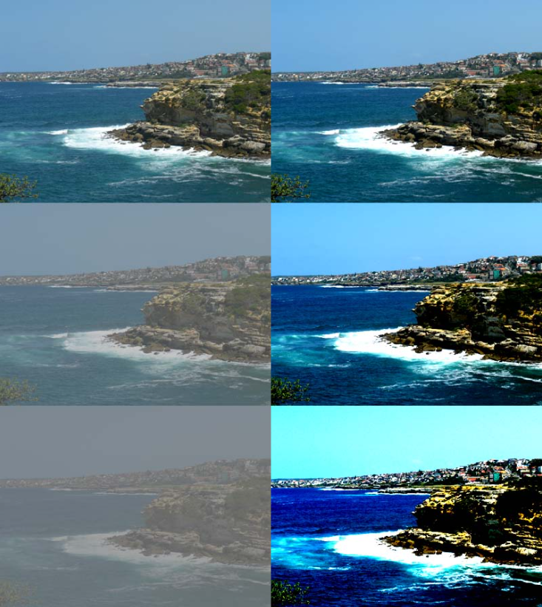
Contrast images:

Slide 14
Masking image:
Image masking is the process of separating an image from its background, either to cause the image to stand out on its own or to place the image over another background.
In the old days of film stripping, it was done by cutting a physical "mask"--a sheet of material such as rubylith--in the shape of the image, and then projecting the image through it.
The image is converted to HSV color space at first. Then 5 masks, meaning images where only black and a color ranging between some given values, are obtained . The masks correspond to red, white, blue and white.
Two masks are obtained for the color red as, the HSV color space being a circular one, red’s range is present on the upper, as well as on the lower boundary. Finally, the masks are combined.

Slide 15
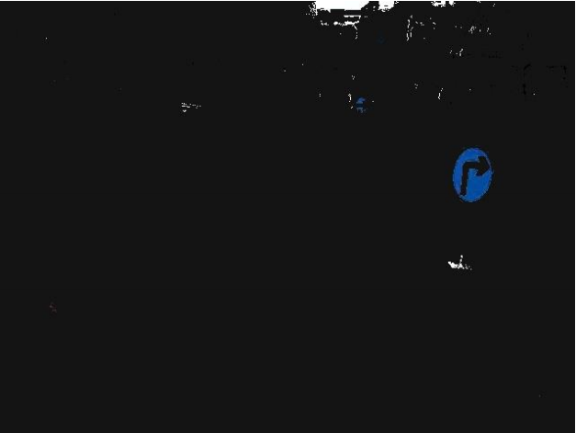
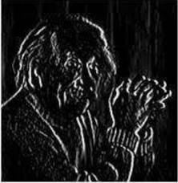
Masking image:

Slide 16
Canny Edge Detection:
The Canny edge detector is an edge detection operator that uses a multi-stage algorithm to detect a wide range of edges in images. It was developed by John F. Canny in 1986. Canny also produced a computational theory of edge detection explaining why the technique works.
Detection of edge with low error rate, which means that the detection should accurately catch as many edges shown in the image as possible
The edge point detected from the operator should accurately localize on the center of the edge.
A given edge in the image should only be marked once, and where possible, image noise should not create false edges.
Then the intensity gradient is found for each pixel, all the pixels that are not local maximums being removed afterwards.
Thresholding is then considered, based on two dynamic values, computed using the median of the image.
Finally, only hard edges are obtained.
The final part of preprocessing is converting the image to binary, leaving only black and white. After this, all the small components are removed by finding if their sizes, found through analyzing connected components, are below a given threshold

Slide 17
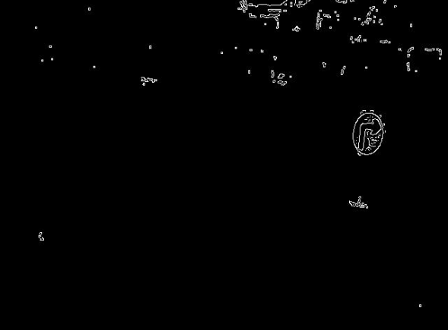
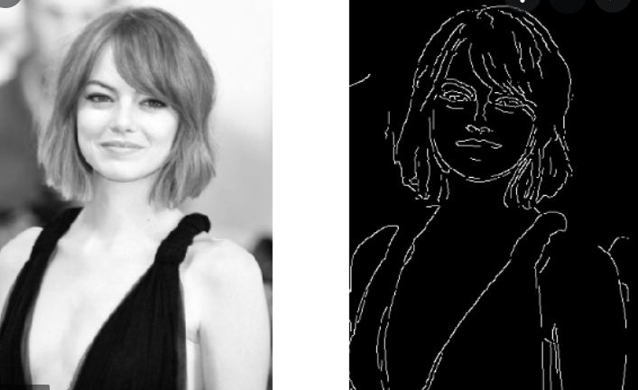
Canny edge detection:

Slide 18
Contour Handling:
Contours handling is a process can be explained simply as a curve joining all the continuous points (along with the boundary), having same color or intensity. The contours are a useful tool for shape analysis and object detection and recognition.
Contours can be found easily on the obtained images by using the cv2 function called findContour().
To find out if the contour really is a sign, its signature is compared to that of a circle.( The signature is found by dividing the distance from the center to each point of the contour to the maximum found distance, and averaging them.)
If the threshold to which the value is compared is high enough, it will work for triangles and diamonds too, as all the signs are symmetric.
Only the largest signs is cropped out of the image and passed on to classification.

Slide 19

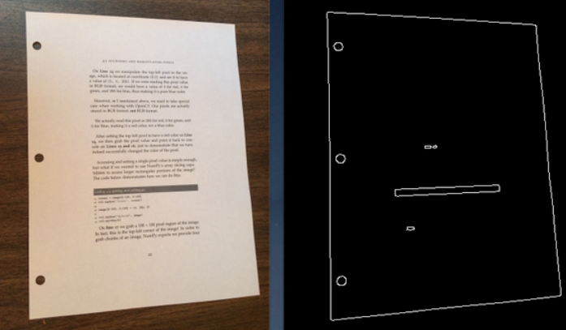
Contour Handling:

Slide 20
Classification:
Various CNNs will be used for classification, but the dataset, training, validation and evaluation will be done in the same way, only the architecture of the neural network being different.
The training data was split into three parts: training, with the most numerous images;
Validation, used for computing the loss, a metric measuring how far the desired output is with respect to the actual output; and evaluation, which helps evaluate the trained model.
When loading the images in memory, all of them are resized to 32x32 pixels, then local details are enhanced using an adaptive histogram and finally scaled between 0 and 1.
The classes are weighted, as the numbers of images differ dramatically from one class to another.
Weighting the classes prevents the model from certain classes taking over the probabilities.
Augmenting the images by applying transformations like zooming, rotation, shifting and shearing prevents over fitting.

Slide 21
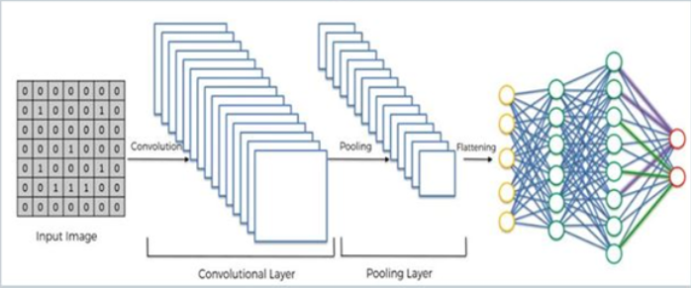
Voting:
When trying to classify an input image, more CNN models will be used, each of them voting three labels, based on prediction accuracy.
In order for the label to be voted, the accuracy should be greater than a given threshold, by default 90%.
The label with the greatest sum is the winner, if there exists one.

Slide 22
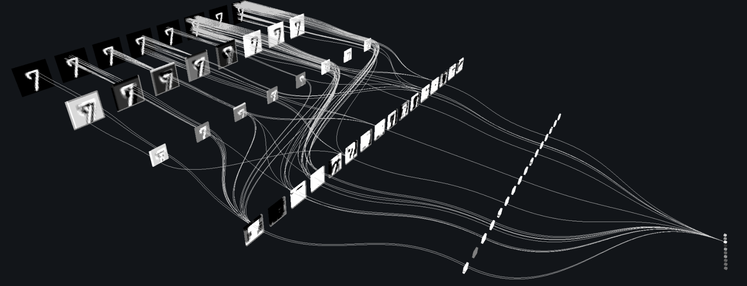
Reconciliation:
When put together, the two parts work well, as the majority of the erroneous data sent by the detector is rejected by the classifier.
Voting certainly helps, as more models that behave differently can classify an image and come up with the best statistical result.

Slide 23
Convolutional Neural Network:
A Convolutional Neural Network (ConvNet/CNN) is a Deep Learning algorithm which can take in an input image, assign importance (learnable weights and biases) to various aspects/objects in the image and be able to differentiate one from the other.
The pre-processing required in a ConvNet is much lower as compared to other classification algorithms. While in primitive methods filters are hand-engineered, with enough training, ConvNets have the ability to learn these filters/characteristics.
The architecture of a ConvNet is analogous to that of the connectivity pattern of Neurons in the Human Brain and was inspired by the organization of the Visual Cortex.
Individual neurons respond to stimuli only in a restricted region of the visual field known as the Receptive Field. A collection of such fields overlap to cover the entire visual area.

Slide 24
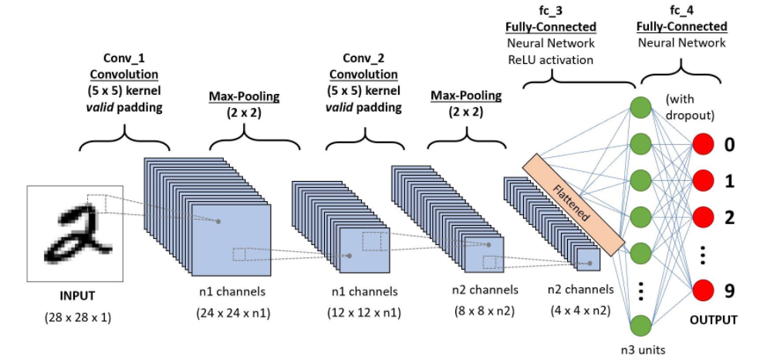
Architecture of CNN:

Slide 25
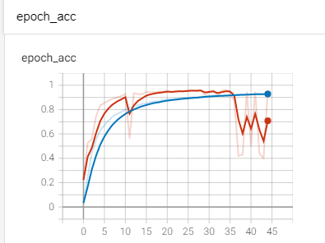

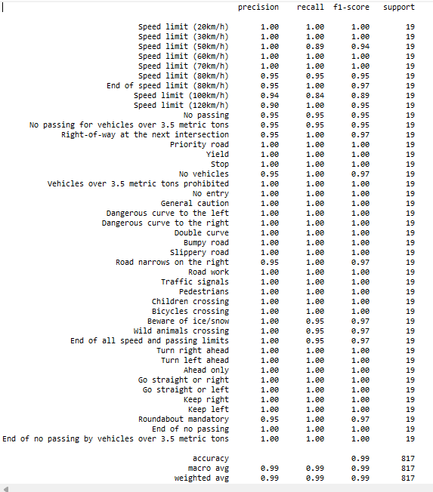
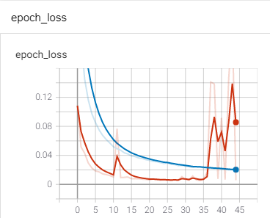
Classification Report of model1:

Slide 26

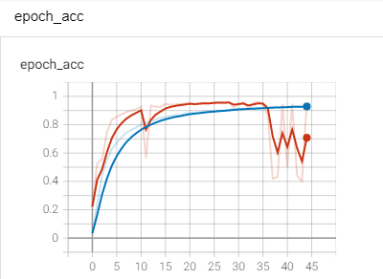
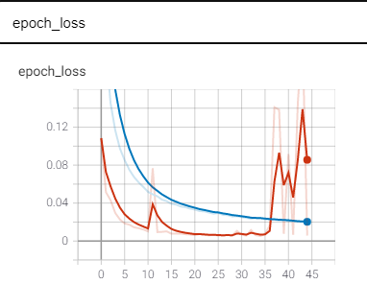
Classification Report of model2:

Slide 27
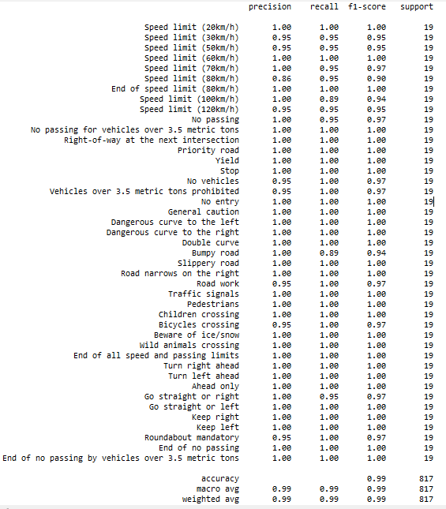
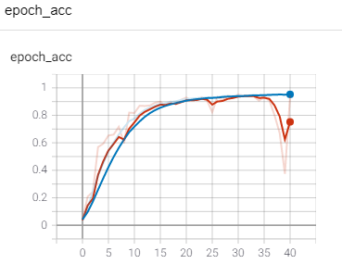
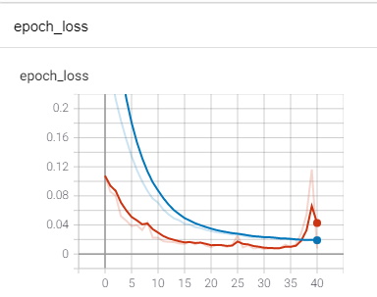
Classification Report of model3:

Slide 28
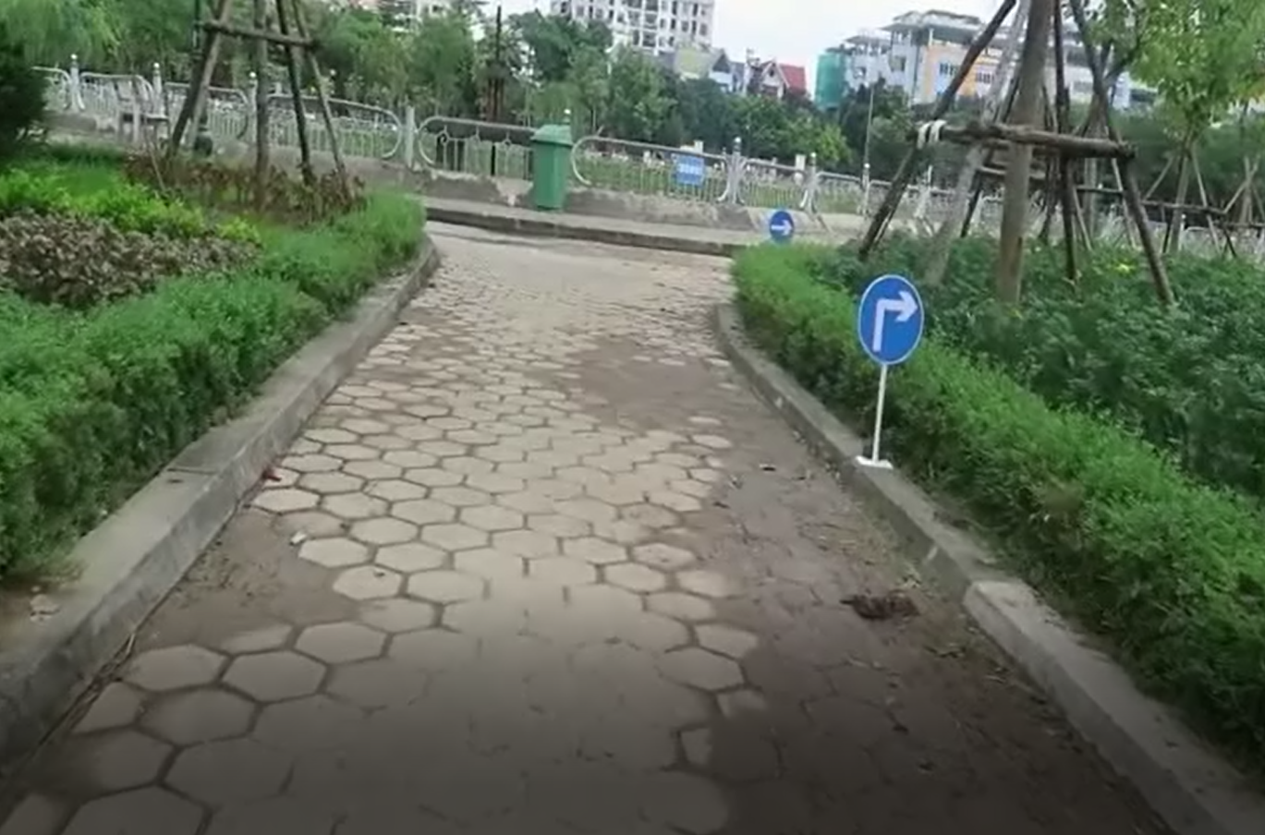
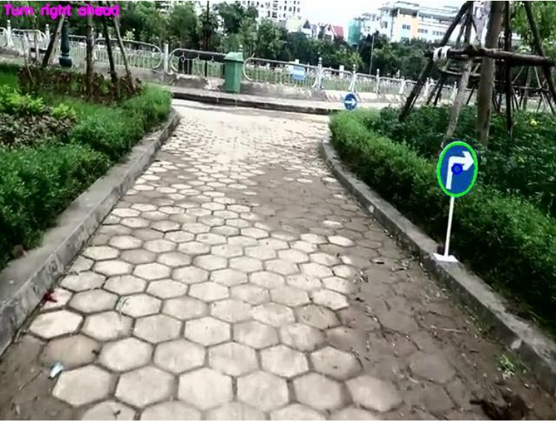
Output:

Slide 29
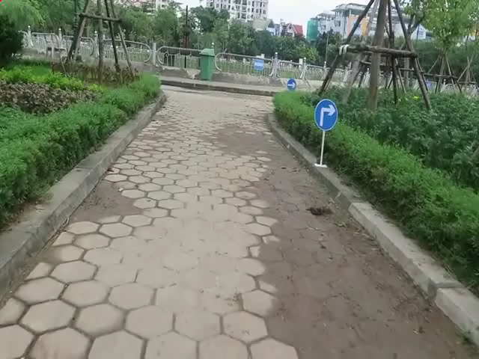
Output :

Slide 30
Conclusion:
The sign meaning is predicted using webcam.
The trained models have attained an accuracy above 95%.

Slide 31
REFERENCES:
[1] Satoshi Suzuki and KeiichiA be. Topological structural analysis of digitized binary images by border following. Computer Vision, Graphics, and Image Processing, 30(1):32–46, apr 1985
[2]Arturo de la Escalera, Luis Moreno, Miguel Salichs, and J.M. Armingol. Road traffic sign detection and classification. Industrial Electronics, IEEE Transactions on, 6:848 – 859, 12 1997.
[3]A Method for Traffic Sign Recognition with CNN using GPU Alexander Shustanov and Pavel Yakimov
[4]Jun Miura, Tsuyoshi Kanda, and Yoshiaki Shirai. An active vision system for on-line traffic sign recognition. volume E85d, pages 52 – 57, 02 2000.
[5]C. Liu, F. Chang, Z. Chen, and D. Liu. Fast traffic sign recognition via high-contrast region extraction and extended sparse representation. IEEE Transactions on Intelligent Transportation Systems, 17(1):79–92, Jan 2016.
[6]Miguel Garrido, Miguel-Angel Sotelo, and E. Martm-Gorostiza. Fast traffic sign detection and recognition under changing lighting conditions. pages 811 – 816, 10 2006.
[7]Karla Brki´c and Axel Pinz. Traffic sign detection as a component of an automated traffic infrastructure inventory system. 03 2020.
[8]st´ephane Estable, J. Schick, Fridtjof Stein, R. Janssen, R. Ott, W. Ritter, and Y.-J Zheng. A real-time traffic sign recognition system. pages 213 – 218, 11 1994.
[9]Fatin Zaklouta, Bogdan Stanciulescu, and Omar Hamdoun. Traffic sign classification using k-d trees and random forests. pages 2151 – 2155, 09 2011.
[10]Pierre Sermanet and Yann Lecun. Traffic sign recognition with multi-scale convolutional networks. pages 2809 – 2813, 09 2011.

Slide 32
THANK YOU

